Slide 1
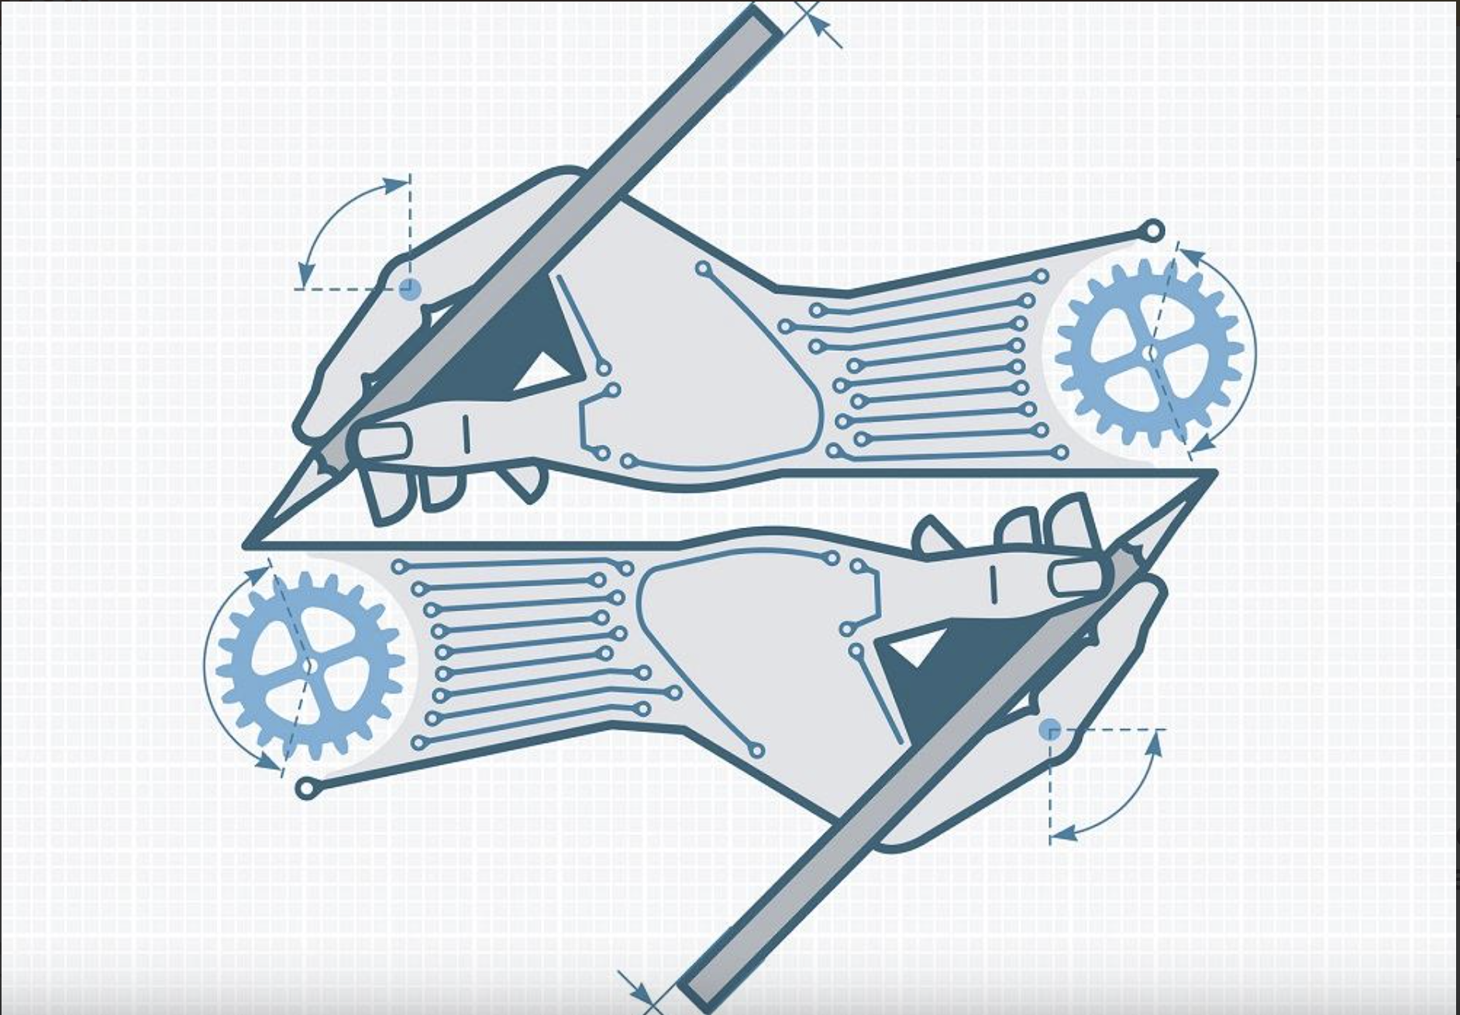
Math409
Self-Attention and its Application

Slide 2
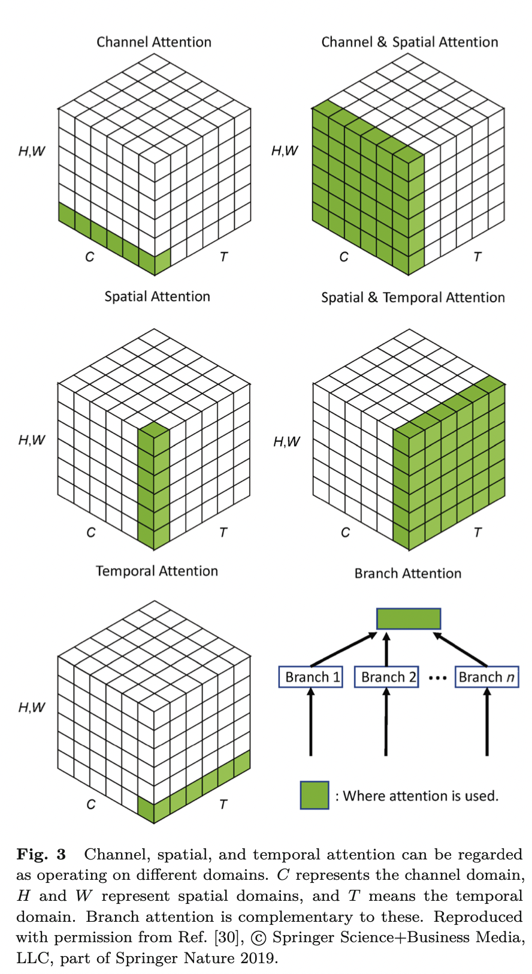
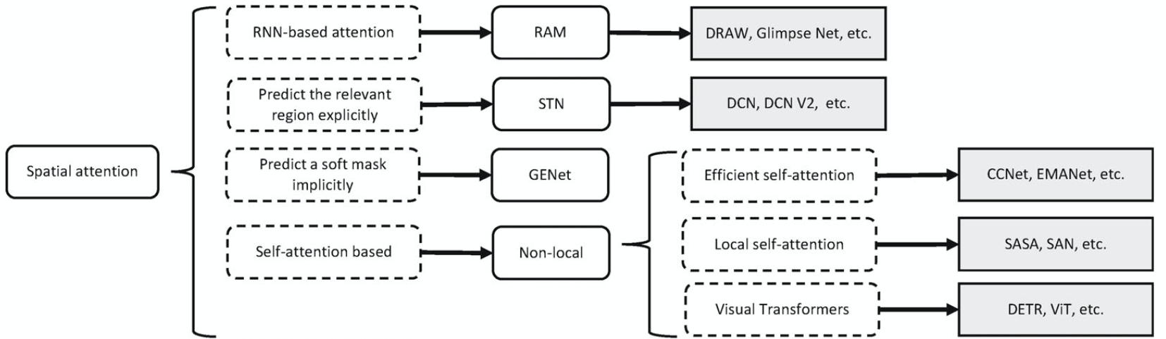
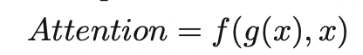
Spatial Attentions: Where to pay attention?
Other Attention Categories: Channel Attention, Temporal Attention, Branch Attention, etc.
General Form:
Guo, Meng-Hao, et al. "Attention mechanisms in computer vision: A survey." Computational visual media 8.3 (2022): 331-368.

Slide 3
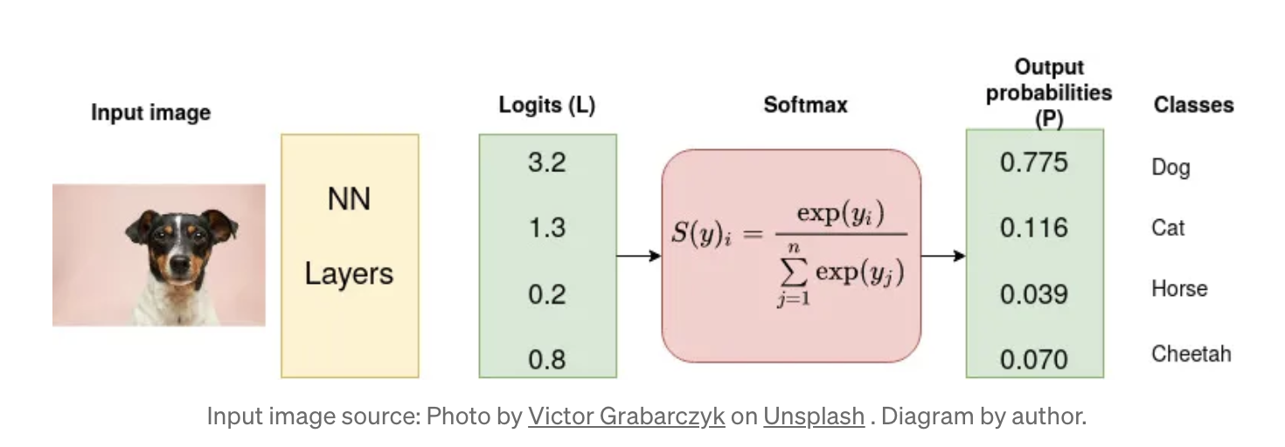
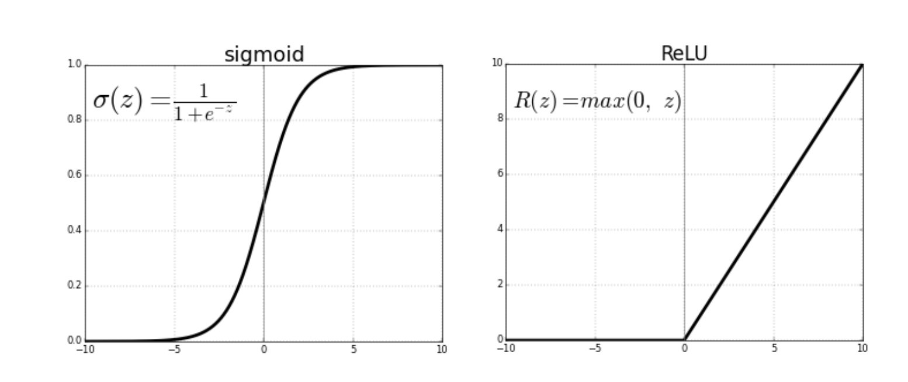
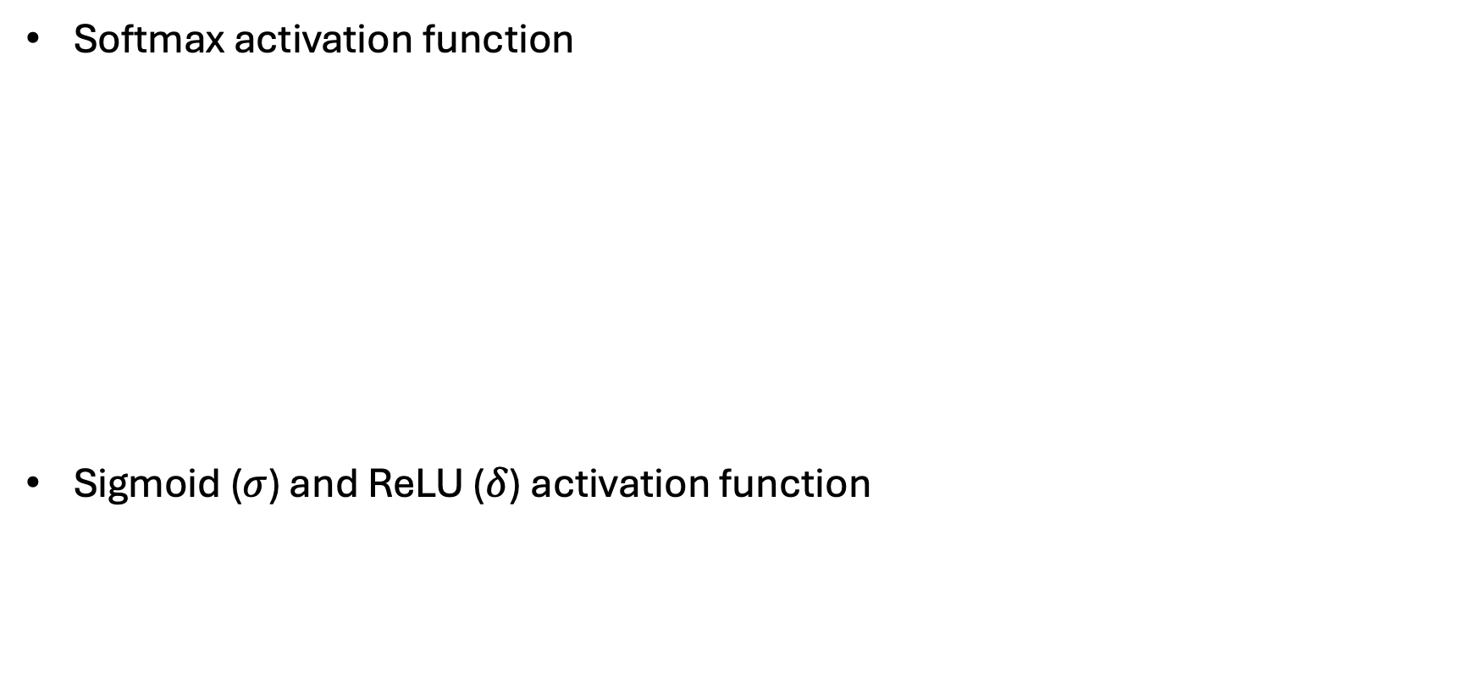
Useful Functions
Softmax activation function
Sigmoid ($σ$) and ReLU ($δ$) activation function

Slide 4
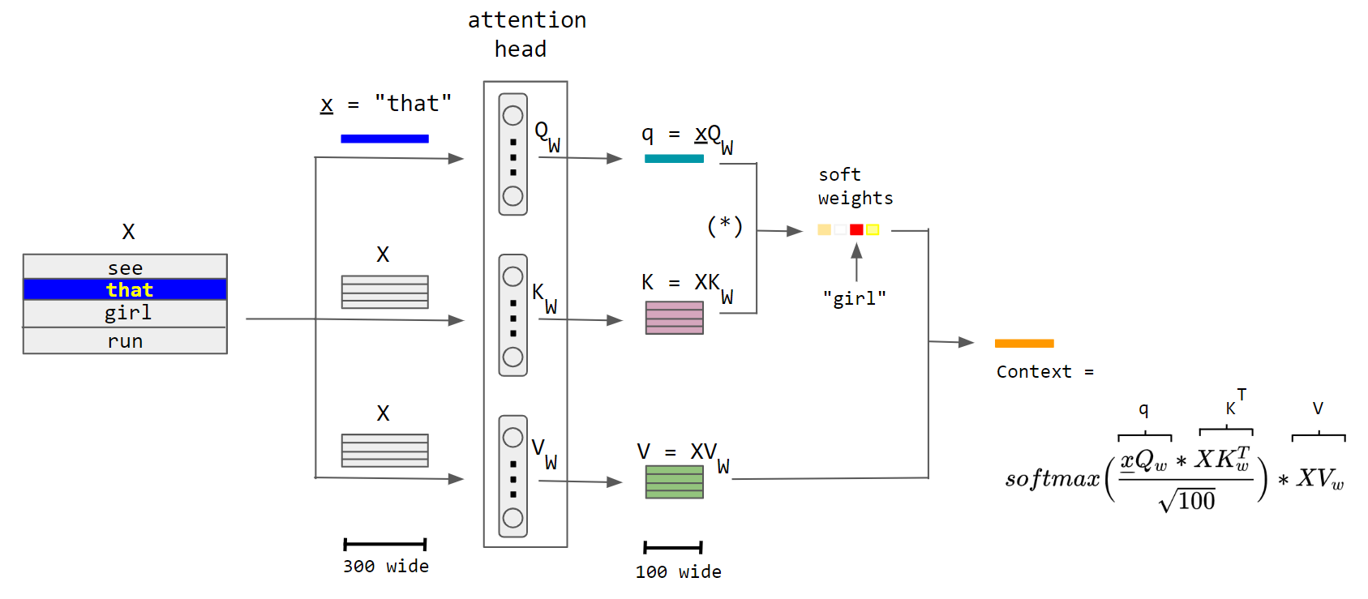
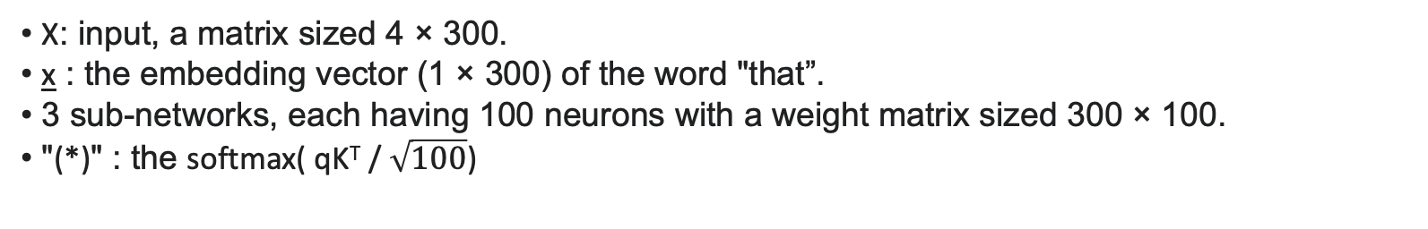
Single Attention Head: An example
Find the most relevant word for “that”:
X: input, a matrix sized 4 × 300.
x : the embedding vector (1 × 300) of the word "that”.
3 sub-networks, each having 100 neurons with a weight matrix sized 300 × 100.
"(*)" : the softmax( qK^{T} / $\sqrt{100}$)
Query (Q), Key (K), and Value (V)
Notes:
The sentence is sent through 3 streams (left), which emerge at the end as the context vector (right). The word embedding size is 300 and the neuron count is 100 in each sub-network of the attention head.

Slide 5
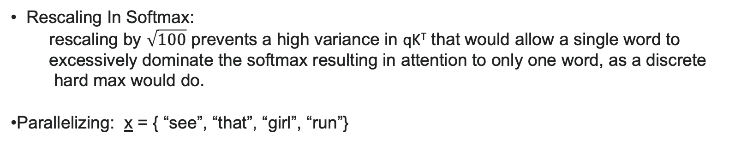
Single Head Attention : An example
Rescaling In Softmax:
rescaling by $\sqrt{100}$ prevents a high variance in qK^{T} that would allow a single word to
excessively dominate the softmax resulting in attention to only one word, as a discrete
hard max would do.
Parallelizing: x = { “see”, “that”, “girl”, “run”}
Notes:
The sentence is sent through 3 streams (left), which emerge at the end as the context vector (right). The word embedding size is 300 and the neuron count is 100 in each sub-network of the attention head.

Slide 6
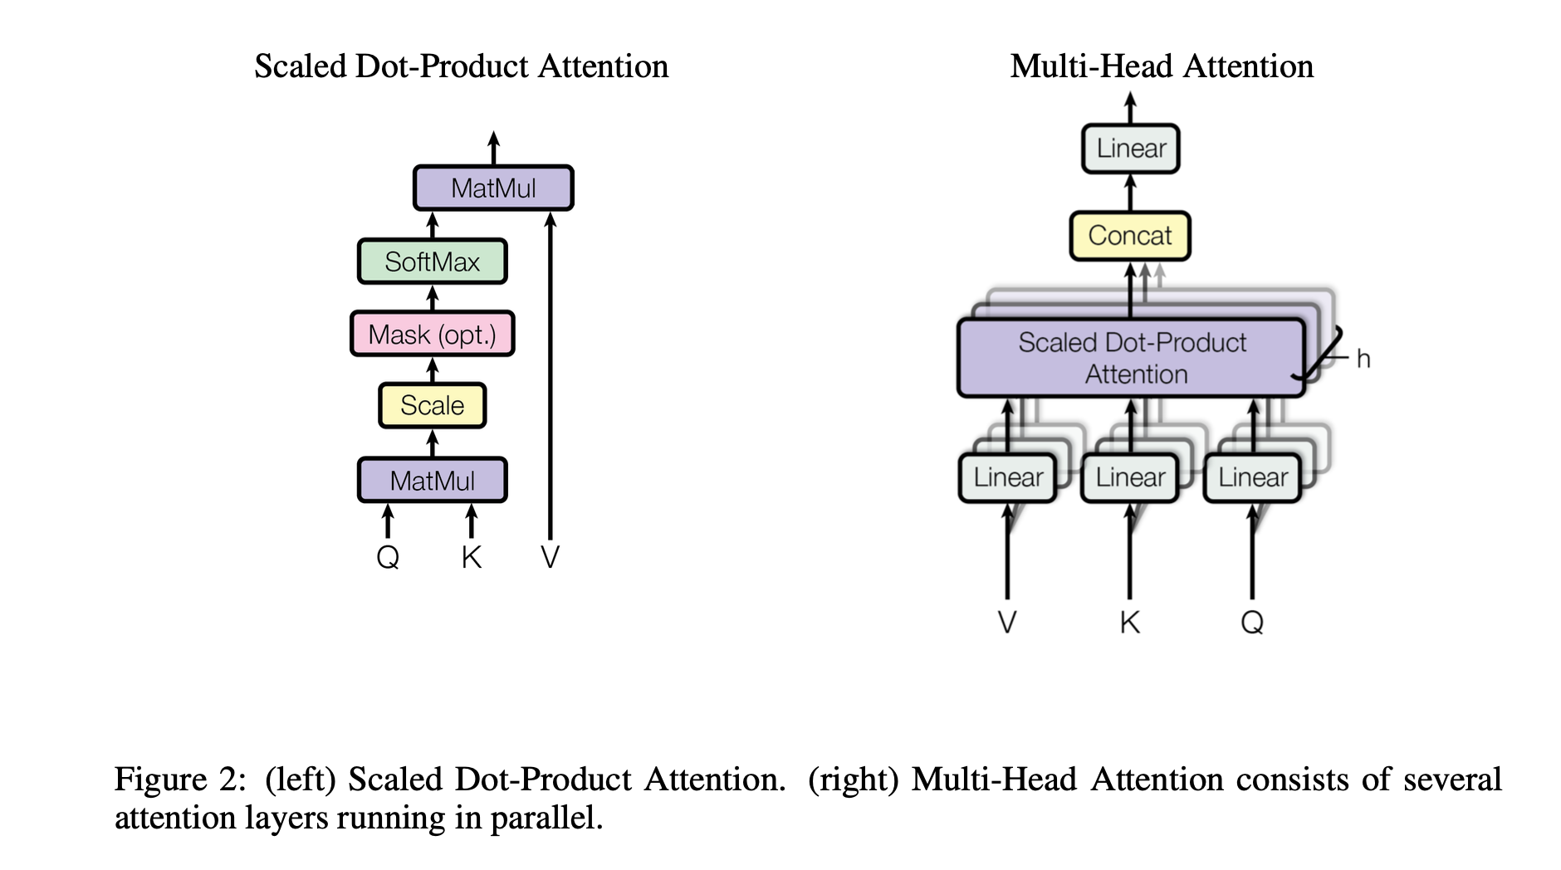
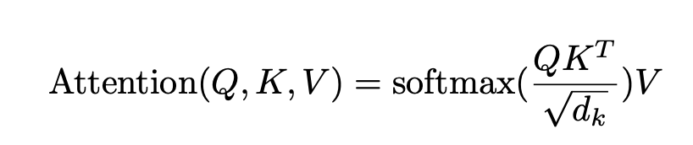
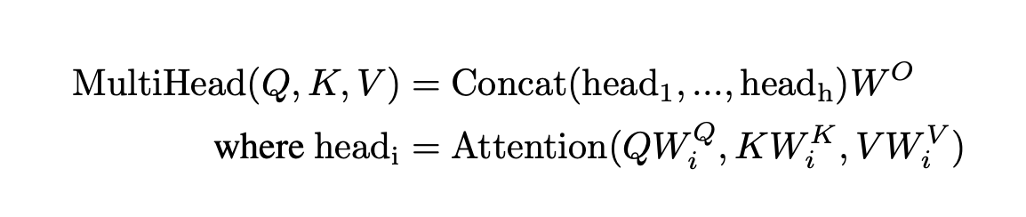
Head Attentions

Slide 7
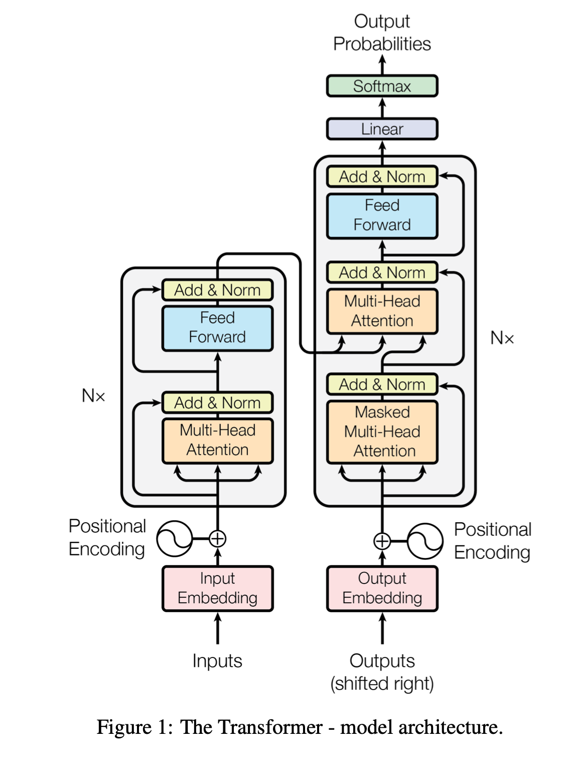
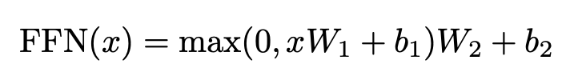
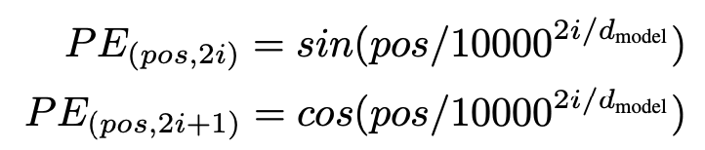
Transformer
Encoder:
N=6 identify layers, only the 1st one needs embedding
Two sub-layers:
Multi-Head Attention:
Feed-forward neural network (ReLU)
LayerNorm(x + Sublayer(x)) after each sub-layer
Positional Encoding (contains no recurrence and no convolution)
information about the relative or absolute position of the tokens in the sequence
Decoder:
Three sub-layers:
2 sub-layers like the encoder + 1 multi-head attention over
the output of the encoder stack
After the masked MHA, get V, K from the output of encoder and Q from the output of masked MHA.
V
K
Q
V
K
Q
V
K
Q

Slide 8
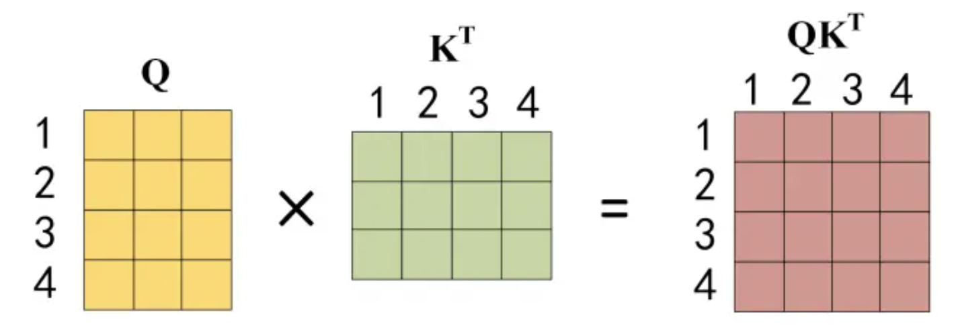
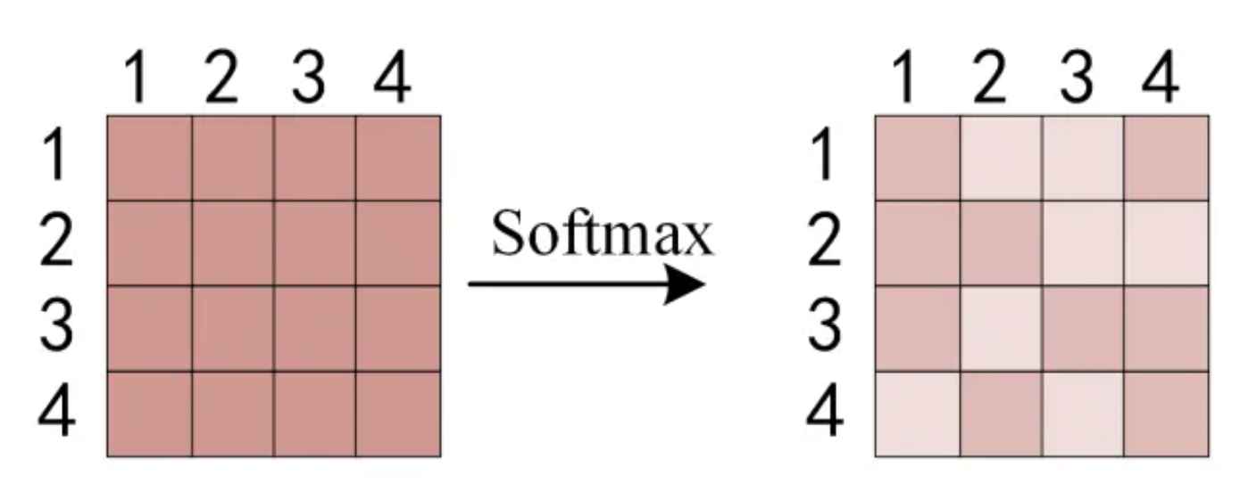
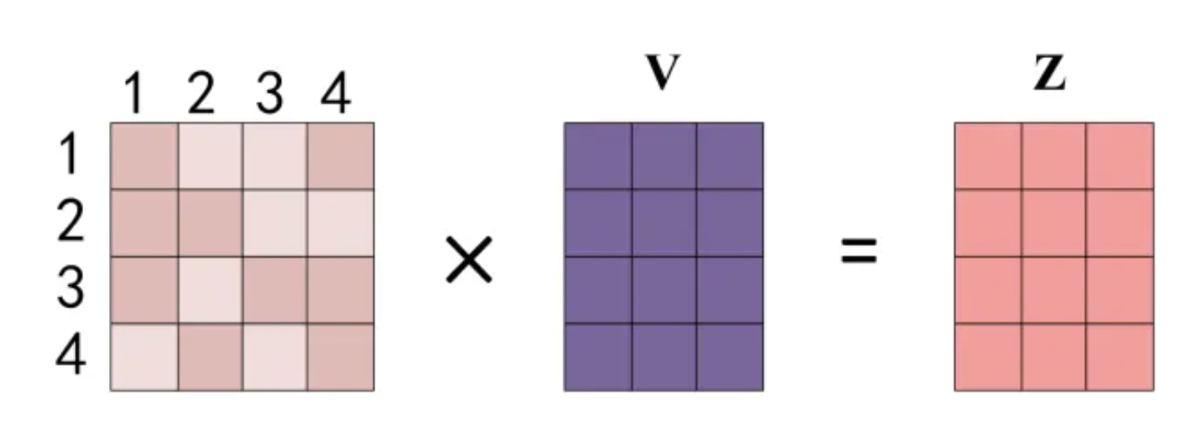
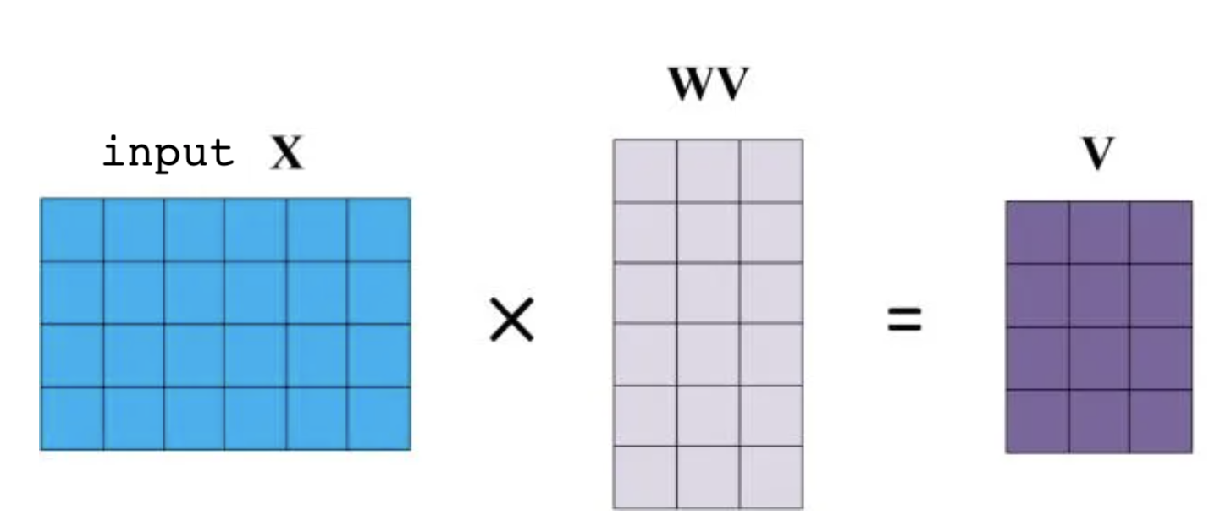
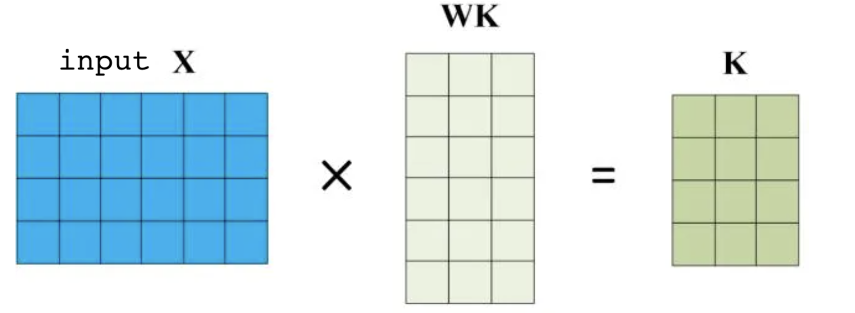
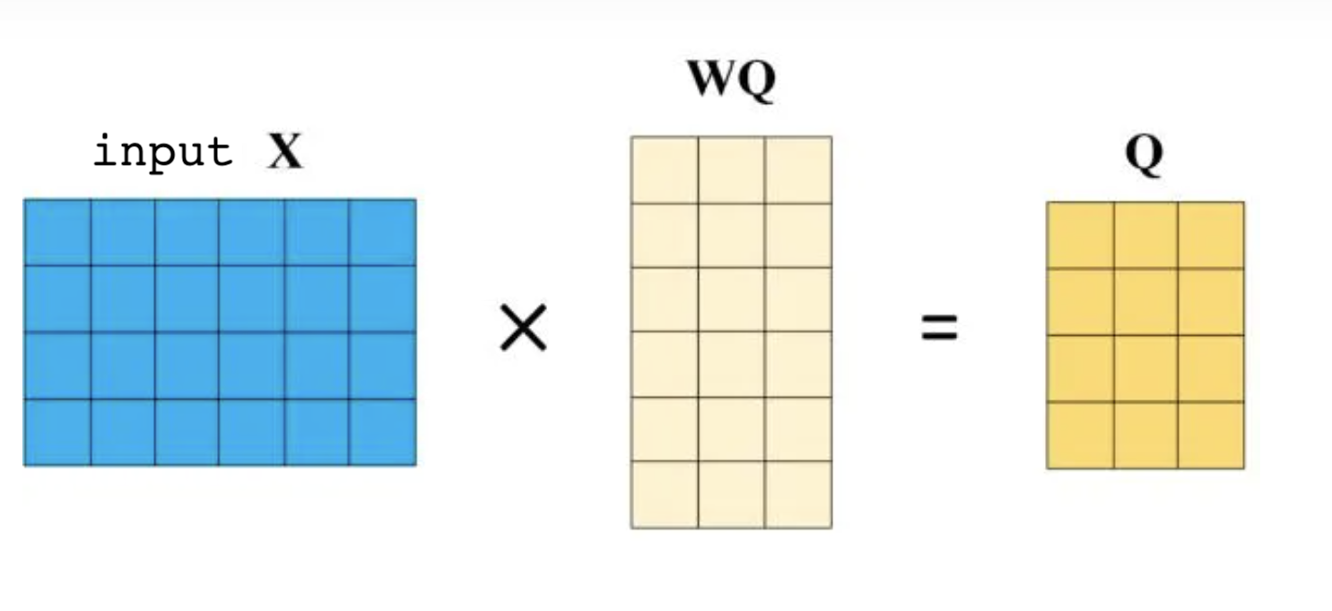
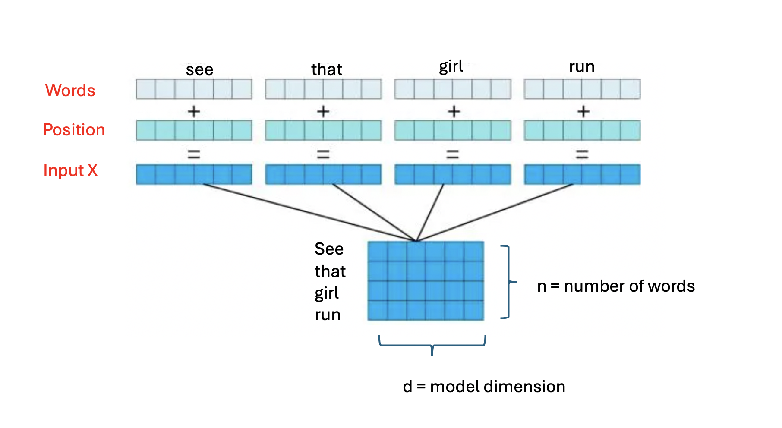
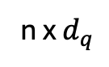
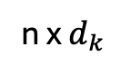
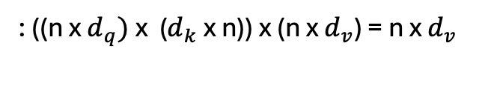
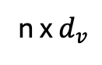
Transformer: Encoder
: ((n x $d_{q})$x ($d_{k}$ x n)) x (n x $d_{v}$) = n x $d_{v}$
V
K
Q
n x $d_{v}$
n x $d_{k}$
n x $d_{q}$
X
V
K
Q
V
K
Q

Slide 9
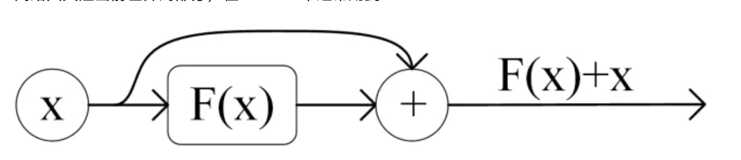
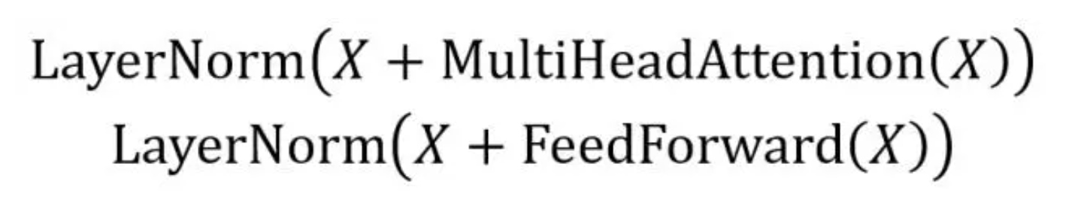
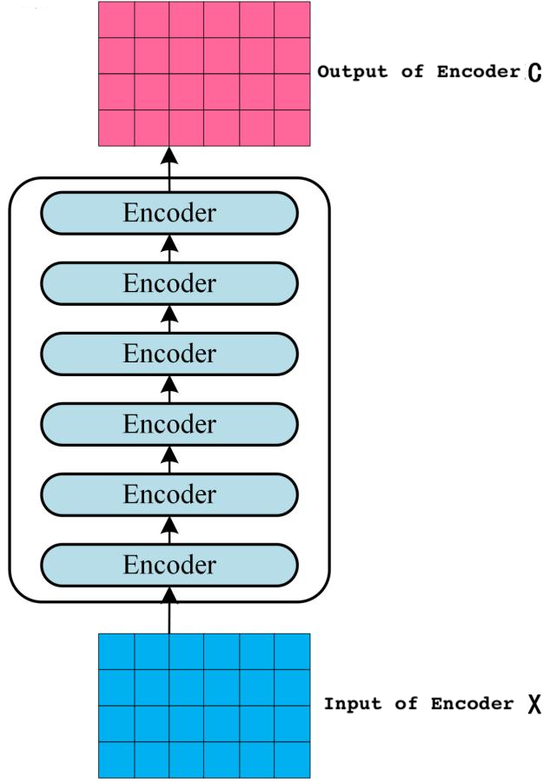
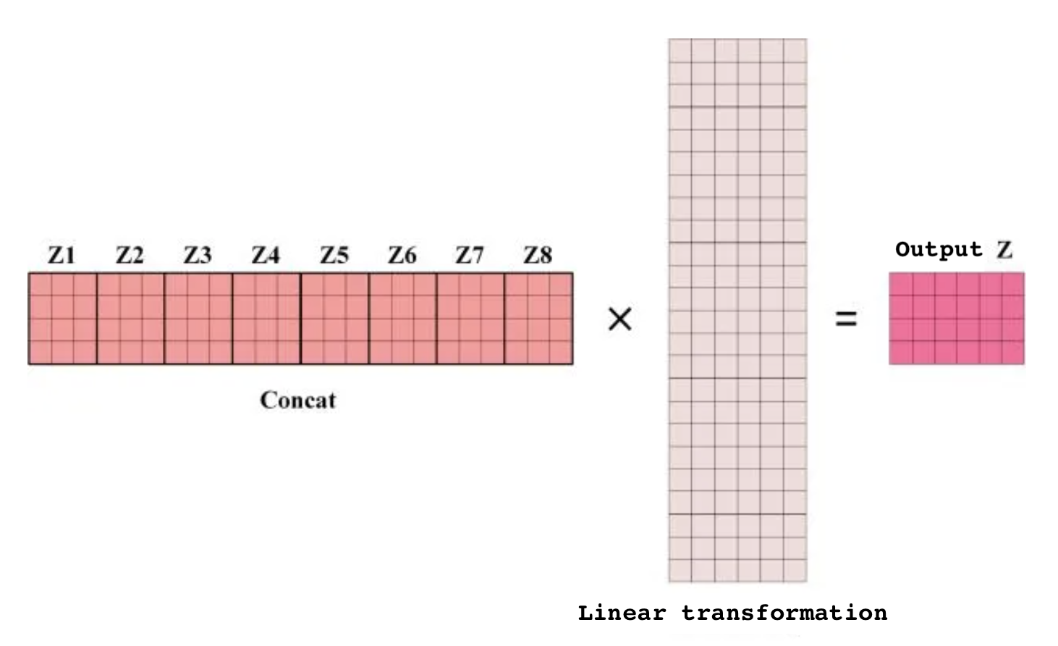
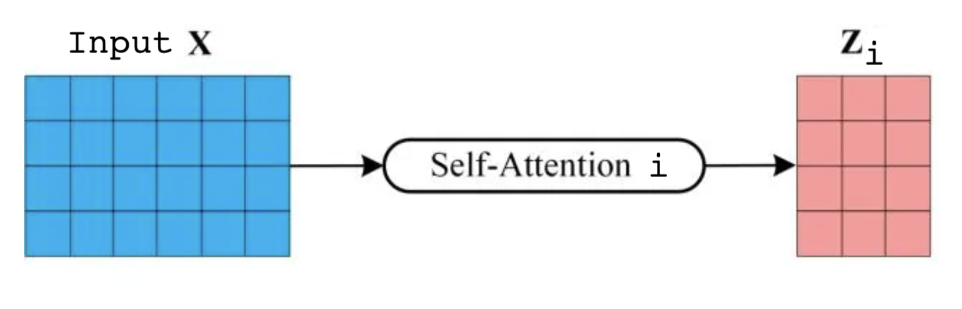
Transformer: Encoder(conti.)
Stacking
skip (or residual) connection
V
K
Q
Z
X
V
K
Q
V
K
Q
Multi-Head: i=1,…,h

Slide 10
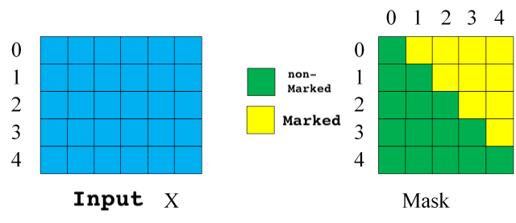
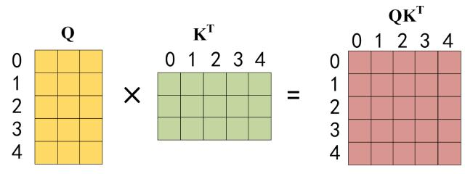
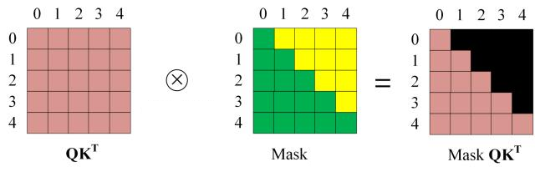
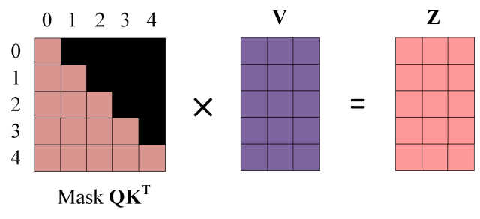
Transformer: Decoder (The masked MHA)
V
K
Q
Z
X
V
K
Q
V
K
Q
Hadamard
product

Slide 11

Transformer : Encoder-Decoder Transformer (Predict)
https://jalammar.github.io/illustrated-transformer/?ref=gptechblog.com

Slide 12

Transformer : Encoder-Decoder Transformer (Predict)
https://jalammar.github.io/illustrated-transformer/?ref=gptechblog.com

Slide 13

Transformer: Encoder-Decoder Transformer (Predict conti.)
https://jalammar.github.io/illustrated-transformer/?ref=gptechblog.com

Slide 14
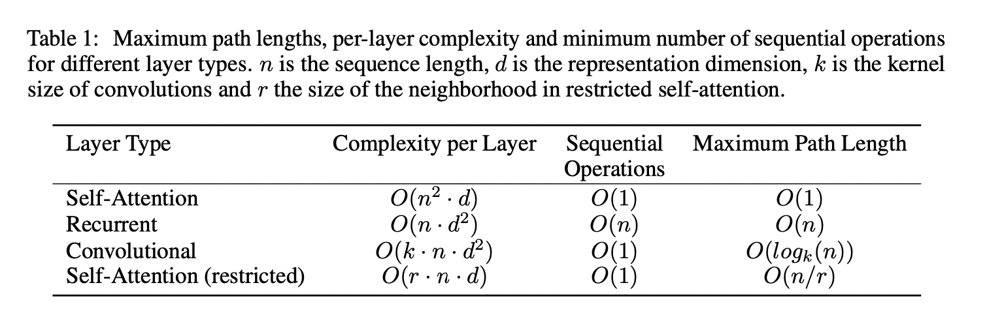
Motivation: Why Self-Attentions?

Slide 19
Spatial Attentions
Squeeze: using GAP to collect the global spatial information
Excitation: captures channel-wise relationships and outputs an attention vector by using fully-connected layers and non-linear layers
Features: emphasizing important channel and suppressing noise.
Weaknesses:
GAP is too simple as a first-order statistics
Fully-connected layer in excitation increases the complexity

Slide 20
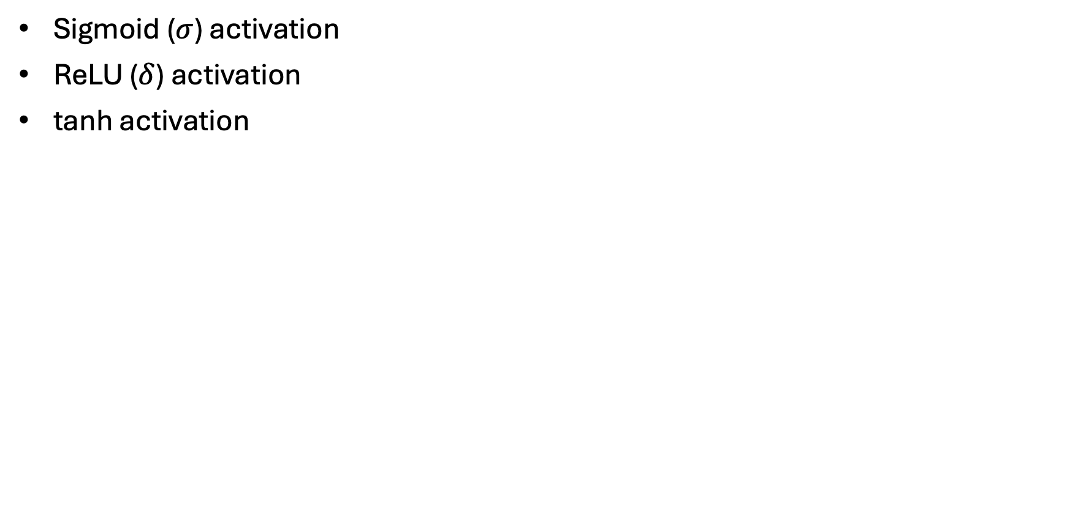
Useful Functions
Sigmoid ($σ$) activation
ReLU ($δ$) activation
tanh activation

Slide 21
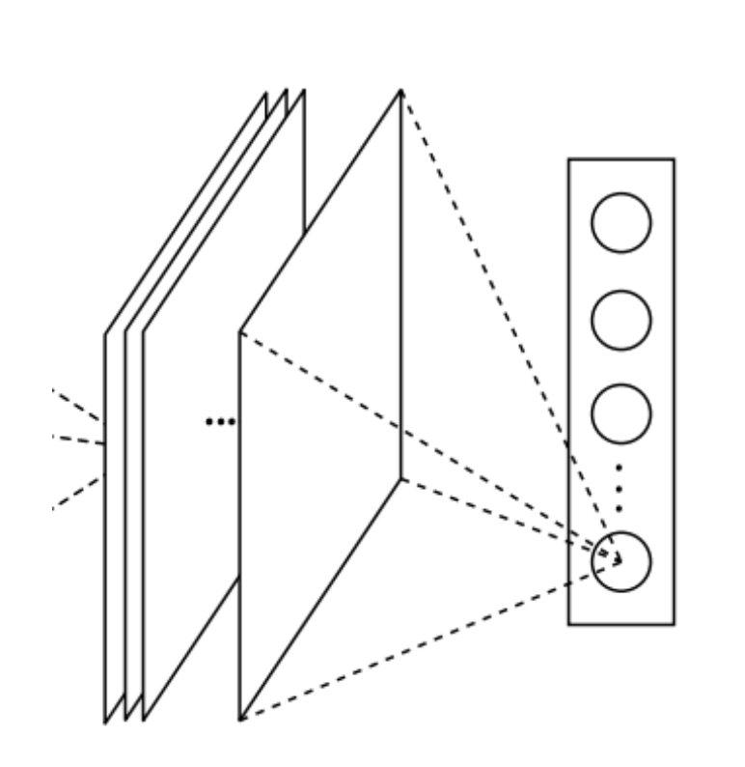
Useful Functions
Global Average pooling (GAP)
Global Second-Order pooling ()

Slide 22
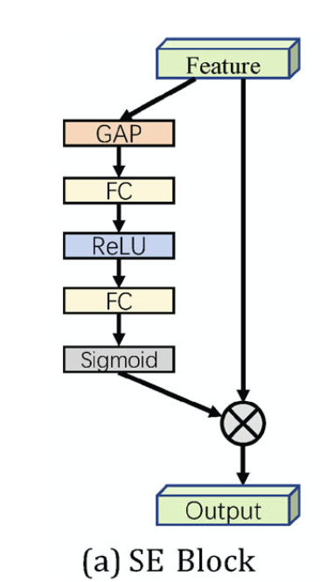
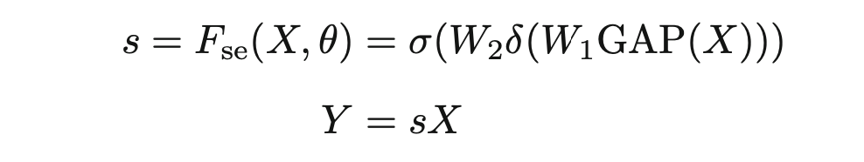
Channel Attentions: SENet
Squeeze: using GAP to collect the global spatial information
Excitation: captures channel-wise relationships and outputs an attention vector by using fully-connected layers and non-linear layers
Features: emphasizing important channel and suppressing noise.
Weaknesses:
GAP is too simple as a first-order statistics
Fully-connected layer in excitation increases the complexity

Slide 23
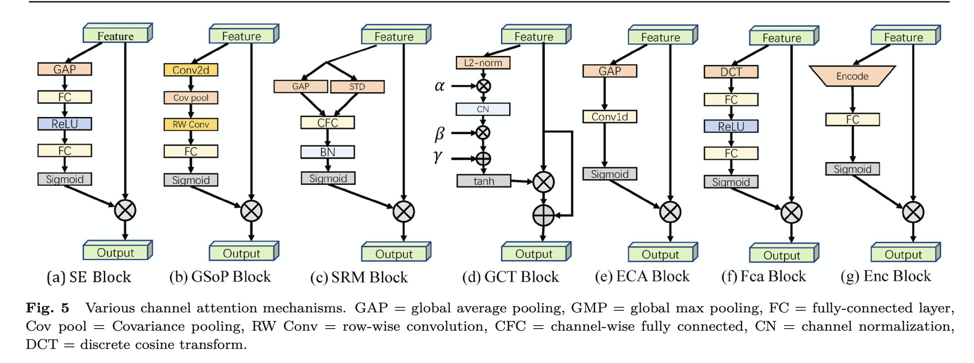
Channel Attentions

Slide 24
Channel Attentions: SENet
Squeeze: using GAP to collect the global spatial information
Excitation: captures channel-wise relationships and outputs an attention vector by using fully-connected layers and non-linear layers
Features: emphasizing important channel and suppressing noise.
Weaknesses:
GAP is too simple as a first-order statistics
Fully-connected layer in excitation increases the complexity

Slide 25
Channel Attentions: GSoP-Net
Squeeze: using GAP to collect the global spatial information
Excitation: captures channel-wise relationships and outputs an attention vector by using fully-connected layers and non-linear layers
Features: emphasizing important channel and suppressing noise.
Weaknesses:
GAP is too simple as a first-order statistics
Fully-connected layer in excitation increases the complexity

